Slide 1
Inside the Database Engine
Protocols
Shared Memory / TCP / Named Pipes
Relational Engine
Storage Engine
Parser and Algebrizer
Query Optimizer
Access Methods
Pages
Records
Indexes
LOB
Versioning
Allocation
Utilities DBCC
Bulk Load
Backup
Restore
Buffer Manager
Database Engine
File Manager
Query Compiler
Query Executor
Transaction Services
SQLOS API
Monitoring
Synchronization
Deadlock Monitor
Lazy
Writer
XEvents
Lock Manager
Thread Scheduling
I/O
Resource
Management
Resource Monitor
Scheduler Monitor
Buffer Pool
Memory Manager
Notes:
While all this has been running, several other parts of SQLOS have been active:
Monitoring: DMVs, Extended Events (xEvents), and so on.
Deadlock Monitor thread: Monitors for and deals with deadlocks.
Lazy Writer threads: Clock sweeping the buffer pool to maintain the free lists and responsible for writing dirty pages to disk between checkpoints.
Scheduler Monitor thread: Monitors scheduler health and detects issues such as non-yielding scenarios.
Resource Monitor thread: Monitors available memory from operating system and internal to SQL Server and notifies the Clerks.
The Hosting APIs for external components interface with Microsoft Data Access Components (MDAC) and common language runtime (CLR).
The Storage Engine manages all data access, both through transaction-based commands (with the Transaction Manager) and bulk operations such as backup, bulk insert, and certain Database Console Command (DBCC) commands.
Access Methods is an important component of the Storage Engine, and contains components to open a table, retrieve qualified data, and update data.
The Access Methods code does not actually retrieve the pages, it will make a request to the Buffer Manager, which holds a copy of the requested data pages in memory (and if the requested page is not in memory, it will retrieve it from disk). By memory, we mean specifically the Buffer Pool, which is part of the SQLOS.
The Transaction Manager ensures that transactions adhere to the ACID properties: atomicity, consistency, isolation, and durability.
It also outlines the boundaries of statements that must be grouped together to form an operation, and it allows “nested” transactions by managing savepoints, if any. Furthermore, it also coordinates with the Lock Manager regarding when locks can be released, based on the isolation level in effect. It also coordinates with Access Methods to determine when old versions of rows are no longer needed and can be removed from the version store.
The File Manager handles actual physical access to data and log files, as well as access to backup devices.
Also included in the storage engine are components for controlling utilities such as Bulk Load, DBCC commands, and Backup/Restore operations.
The SQLOS layer handles activities that are normally considered to be operating system-like responsibilities, such as Thread Scheduling, Synchronization services (latching and deadlock detection), Memory management (including the Buffer Pool), Lock management, I/O management (which establish the completion routines for read/write operations from memory to disk and vice-versa) , and Monitoring (such as DMVs and xEvents).
Locking is a crucial function of a multi-user Remote Desktop Management Services (RDMS) such as SQL Server, even if you are operating an optimistic concurrency model such as snapshot isolation level, to help ensure the isolation and consistency properties of ACID. This is handled by the Lock Manager, whose main job is to provide hierarchical access to data in a concurrent fashion (as allowed by the Isolation Level of the transaction), by managing compatibility between the lock types. It also resolves deadlocks (with the aid of the Deadlock Monitor thread), and escalates locks if needed. Other components such as the other threads in the figure will be explained in an upcoming lesson in this module.

Slide 2
SQL Server Operating System (SQLOS)
Application layer between Microsoft SQL Server components and the Windows Operating System.
Centralizes resource allocation to provide more efficient management and accounting.
The SQLOS is used by the SQL Server relational database engine for system-level services.
Abstracts the concepts of resource management from components, providing:
Scheduling and synchronization support
Memory management and caching
Resource governance
Diagnostics and debug infrastructure
Scalability and performance optimization
Notes:
Abstracts the concepts of resource management from components, providing:
Scheduling and synchronization support
Memory management and caching
Resource governance
Diagnostics and debug infrastructure
Scalability and performance optimization
Key Points:
Hardware technology and architectures continue to evolve. The introduction of SQL Server Operating System (SQLOS) allows SQL Server to respond to these new architectures with greater flexibility and control.
The SQLOS was created to centralize common low-level tasks within the SQL Server process. Having a central location for these tasks means less duplication of code within the various components of the engine, and it also offers the flexibility to adjust SQL Server to new and advanced hardware architectures without impacting the other areas of SQL Server code.
The SQLOS behaves very similar to an operating system. It abstracts the concept of memory management, I/O, scheduling and so on, from the other components within the SQL Server engine. In this way, these components do not need to worry about managing things such as Non-Uniform Memory Access (NUMA) and Resource Governor. They simply make resource allocation calls to the SQLOS via an application programming interface (API).
The SQL engine is still a process similar to any other process running on a Windows server. It does not have any special privileges or priority over other process. The SQLOS does not bypass Windows; it simply manages the resources within the SQL Server process space in a way that is efficient for SQL Server.
Example:
In the event of memory pressure on the server, Windows will respond by trimming processes’ memory (that is moving it from RAM into the paging file). To avoid this performance impact, the SQLOS will monitor physical memory levels on the server and preemptively trim the SQL Server memory footprint in a way that will have the least effect on performance, thereby returning physical memory to the operating system before it must resort to paging.
Because all the resources are being managed within the SQLOS using a common framework, the job of monitoring resource consumption is simplified, both for the SQL Server process itself, and for the Database Administrator (DBA).
Additional Reading:
SQLOS Resources: http://blogs.msdn.com/b/sqlosteam/archive/2010/06/23/sqlos-resources.aspx

Slide 3
Two Main Functions of SQLOS
Management
Memory Manager
Monitoring
Resource Monitor
Process Scheduler
Synchronization
I/O
Support for Non-Uniform Memory Access (NUMA) and Resource Governor
Deadlock Monitor
Scheduler Monitor
Lazy Writer (Buffer Pool management)
Dynamic Management Views (DMVs)
Extended Events
Dedicated Administrator Connection (DAC)
Notes:
Key Points:
The two core responsibilities of the SQLOS are Resource Management and Monitoring. All the information used to manage and monitor resources within the SQL Server process space is exposed to the DBA via Dynamic Management Views (DMVs). These views expose the memory structures used within the SQLOS to account for all the resources in use, thus giving the DBA complete knowledge of the state of the SQL Server process.

Slide 4
Dynamic Management Views and Functions
Category | Description
sys.dm_exec_% | Execution and connection information
sys.dm_os_% | Operating system related information
sys.dm_tran_% | Transaction management information
sys.dm_io_% | I/O related information
sys.dm_db_% | Database information
Notes:
While all this has been running, several other parts of SQLOS have been active:
Monitoring: DMVs, Extended Events (xEvents), and so on.
Deadlock Monitor thread: Monitors for and deals with deadlocks.
Lazy Writer threads: Clock sweeping the buffer pool to maintain the free lists and responsible for writing dirty pages to disk between checkpoints.
Scheduler Monitor thread: Monitors scheduler health and detects issues such as non-yielding scenarios.
Resource Monitor thread: Monitors available memory from operating system and internal to SQL Server and notifies the Clerks.
The Hosting APIs for external components interface with Microsoft Data Access Components (MDAC) and common language runtime (CLR).

Slide 5
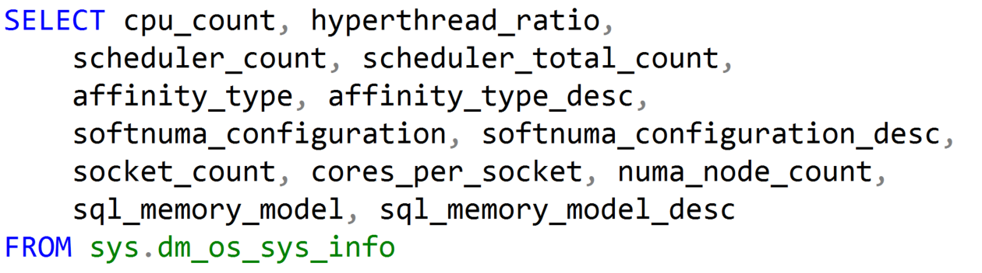
Using Dynamic Management Objects (DMOs)
Must reference using the sys schema
Two basic types:
Real-time state information
Historical information
Notes:
While all this has been running, several other parts of SQLOS have been active:
Monitoring: DMVs, Extended Events (xEvents), and so on.
Deadlock Monitor thread: Monitors for and deals with deadlocks.
Lazy Writer threads: Clock sweeping the buffer pool to maintain the free lists and responsible for writing dirty pages to disk between checkpoints.
Scheduler Monitor thread: Monitors scheduler health and detects issues such as non-yielding scenarios.
Resource Monitor thread: Monitors available memory from operating system and internal to SQL Server and notifies the Clerks.
The Hosting APIs for external components interface with Microsoft Data Access Components (MDAC) and common language runtime (CLR).

Slide 6

CPU Architecture
Physical Hardware
Logical Processors as seen by the OS
Processor Chip
Hyper Thread
Hyper Thread
0
1
2
3
Hyper Thread
Hyper Thread
Core
Core
Hyper Thread
Hyper Thread
4
5
6
7
Hyper Thread
Hyper Thread
Core
Core
Socket
Notes:
A socket is a physical spot on the motherboard that can hold a processor chip.
A processor chip can have a single core, dual core, quad core, etc…
If a core allows more than one thread, it is hyper-threaded.
A thread is a communication line from the operating system to the CPU.
In the slide above there is one socket and one quad core, hyper-threaded processor chip.
Meaning my operating system will see eight logical processors.

Slide 7
Microsoft SQL Server Scheduling Terminology
Batch
A statement or set of statements submitted to SQL Server by the user (a query), also referred to as a request
Monitor with sys.dm_exec_requests
Task
A batch will have one or more tasks (aligns with statements)
Monitor with sys.dm_os_tasks
Worker Thread
Each task will be assigned to a single worker thread for the life of the task
Monitor with sys.dm_os_workers
Notes:
SQL Server Scheduling Terminology
A batch is a query or a set of queries being executed as a whole, it is basically everything between the GO separator as the GO command is a batch terminator.
The GO terminator determines what is going to be sent to SQL Server to be executed. A batch is a single unit of code that is sent to SQL Server, it can be one query or many queries. Internally, a batch from the client to the SQL Server is seen as a request, a request for work to be done.
All of the active requests can be seen in sys.dm_exec_requests. If your query is completed and your session is still open and idle it is not going to show up in sys.dm_exec_requests. It is only something that is actively executing a command or a request.
A task is a unit of work that is scheduled by SQL Server. A request or a batch will have one or more tasks. A very simple query will have one task, but a more complicated query such as one that runs in parallel will have multiple tasks. If you have a large query that runs in parallel and it is broken into separate parts then that query is going to have multiple tasks. You can monitor with sys.dm_os_tasks.
A worker thread is a thread that is assigned to a task to do the work the task requires. This is a logical thread in the SQL Server process. The SQL Server process will have many worker threads. The number of worker threads we have is dynamic. SQL Server will spin up additional threads based on what the current workload is. After the task is complete, the worker thread that was assigned goes back into the pool and will be assigned to another thread when needed from the pool. This can be monitored with sys.dm_os_workers.
These worker threads are being used to send work out to Windows for the CPUs to be executed. So the worker threads in SQL Server will map to an operating system-level thread which is where the work is actually being done. We are managing these threads internally with an internal scheduler but we are also farming them out to the Windows OS to be executed on the CPU so they end up going through the Windows scheduler as well.
Key Points:
Queries are submitted to SQL Server in the form of a batch which may contain one or many statements. Each statement within a batch is executed individually in succession and the results are sent to the client when complete. Typically a batch will result in a single task being executed, but queries that have parallel execution plans will have several tasks that are executed simultaneously (typically resulting in faster execution).
When a task is scheduled, it is assigned to a worker thread. When it is time for the task to do work on a CPU, the SQL Server worker thread is submitted to the operating system for processing and will be assigned to an operating system thread. After the thread is submitted to the operating system for execution, Windows takes over and handles scheduling the thread for execution on one of the system CPUs.
The default maximum number of worker threads can be calculated using the following formula:
Maximum worker threads = (512+ (<# of processors> -4) * 16)
Additional Reading:
SQL Server Batch or Task Scheduling
http://msdn.microsoft.com/en-us/library/ms189267.aspx
Thread and Task Architecture
http://msdn.microsoft.com/en-us/library/ms176043.aspx
Configure the max worker threads Server Configuration Option
http://msdn.microsoft.com/en-us/library/ms190219.aspx
Although the term 'execute' is used commonly in jargon, such as in 'execute a query', it should be avoided whenever possible in Microsoft content because of its violent and militaristic connotations. Do not use 'execute' in content for home users or information workers. Use 'run' instead. If the user interface includes 'execute', the user or program action is still run. Always use 'run' in the context of macros and queries. 'Execute' is acceptable in content for software developers because it has become ingrained, especially in the passive voice. 'Run' is preferable, however, where it does not cause any loss of meaning.
Please check all instances in the document.
I changed this to remove bold and underline as it is against Microsoft style purely for emphasis. Please remove such formatting throughout
Please avoid using first person “we”, “I”, or “our”. Always use “you” or “Microsoft” if that is applicable.

Slide 8
Thread States and Queues
Runnable: The thread is currently in the Runnable Queue waiting to execute. (First In, First Out).
Running: One active thread executing on a processor.
Suspended: Placed on a Waiter List waiting for a resource other than a processor. (No specific order).
Notes:
10987B
1: SQL Server Architecture, Scheduling, and Waits

Slide 9
Yielding
Runnable List
Status: runnable
CPU available
Start
CPU
Status: running
Complete
Quantum exhausted
End
Resource blocked
Waiter List
Status: suspended
Resource available

Slide 10
Task Execution Model
The full cycle between the several task states, for how many times it needs to cycle, is what we experience as the total query response time.
CPU Time (RUNNING)
Total Query Response Time
Signal Wait Time (RUNNABLE)
Resource Wait Time (SUSPENDED)

Slide 11
Relevant Dynamic Management Views (DMVs)
sys.dm_os_wait_stats
Returns information about all the waits encountered by threads that ran.
sys.dm_os_waiting_tasks
Returns information about the wait queue of tasks actively waiting on some resource.
Includes wait type, number of tasks that waited in the specific wait type, total and max wait times, and the amount of signal waits.
sys.dm_exec_requests
Returns information about each request that is in-flight.
Includes session owning the request and status of the request, which will reflect the status of one or more tasks assigned to the request.
Notes:
Additional Reading:
sys.dm_os_wait_stats - Main source of information on waits
(https://msdn.microsoft.com/en-us/library/ms179984.aspx)
sys.dm_os_waiting_tasks - Includes session owning the task, the wait duration and type, information about blocking and the resource that is currently preventing the task from becoming runnable
(https://msdn.microsoft.com/en-us/library/ms188743.aspx)
sys.dm_exec_requests
(https://msdn.microsoft.com/library/ms177648.aspx)
See all waits here: http://blogs.msdn.com/b/psssql/archive/2009/11/03/the-sql-server-wait-type-repository.aspx and http://msdn.microsoft.com/en-us/library/ms179984.aspx

Slide 12
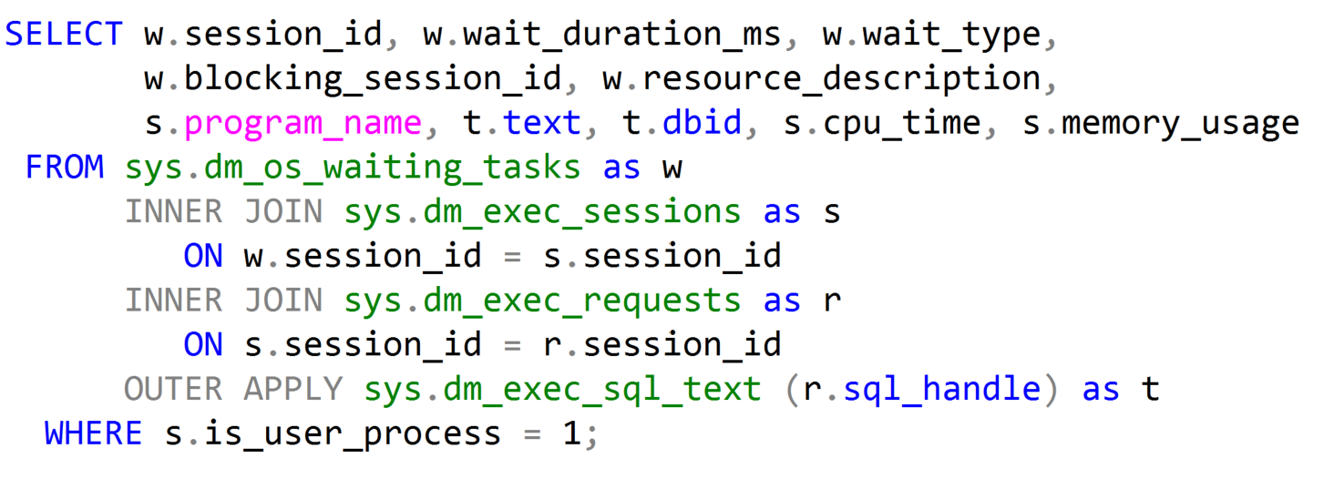
Waiting Tasks DMV
Notes:
Key Points:
Use sys.dm_os_waiting_tasks to show the waiter list at the current moment. sys.dm_exec_requests contains all requests (running, runnable, waiting) that are in-flight, and joining both these DMVs allows us to find what is causing blocking at a given point in time.
Additional Reading:
SQL Swiss Army Knife #11.1 - Locking, blocking and active transactions (http://blogs.msdn.com/b/blogdoezequiel/archive/2012/09/18/sql-swiss-army-knife-11-1-locking-blocking-and-active-transactions.aspx)
Key Points:
The overwhelming majority of scenarios we focus our attention on Resource waits, which may indicate bottlenecks that we have to deal with.
SQL Server bottlenecks may present themselves in different ways:
We might face CPU contention with high CPU consumption and this will have an effect on waits.
Or we might face a situation where available memory is low, also leading to specific wait types.
Disk I/O is also very important, because disk high latencies can slow down any and all operations in SQL Server, and there are specific waits that allow us to scope further actions.
Network I/O should not be overlooked. We might have low bandwidth available, or clients may not be consuming data as fast as SQL Server can provide it – all these have specific cumulative waits in SQL Server.
Then there is transactional locking and blocking, which is paramount for our workload performance, as it represents contention on queries.
The order listed above is not arbitrary. This is the order in which we usually start troubleshooting SQL Server bottlenecks.
Please check if this should be the “waits” list
This sentence reads wrong. Consider changing to “Of all the scenarios that are available, we focus our attention on..”?
Global: Please avoid using first person “we”, “I”, or “our”. Always use “you” or “Microsoft” if that is applicable.

Slide 13
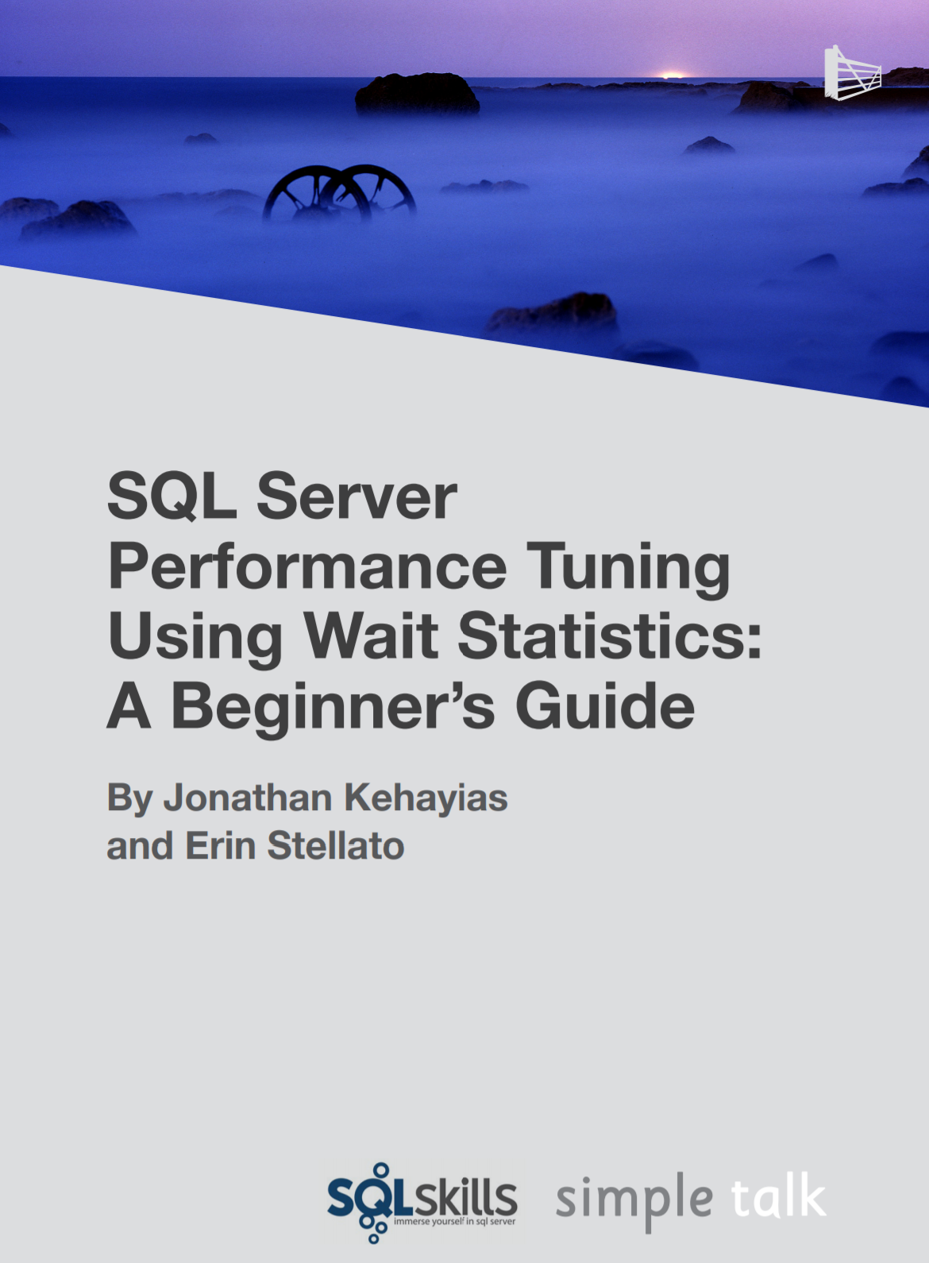
Troubleshooting Wait Types
Aaron Bertrand – Top Wait Types https://sqlperformance.com/2018/10/sql-performance/top-wait-stats
Paul Randal – SQL Skills Wait Types Library https://www.sqlskills.com/help/waits/
Notes:
10987B
1: SQL Server Architecture, Scheduling, and Waits

Slide 14
SQL Server Object Allocation
Data Row
Data Row
Data Row
Free Space
Data Row
Free Space
Data Row
Data Row
Data Row
Data Row
Free Space
Data Row
Free Space
Free Space
Free Space
Free Space
Data Row
Data Row
Data Row
Data Row
Data Row
Data Row
Free Space
Data Row
Data Row
Data Row
Data Row
Free Space
Data Row
Data Row
Free Space
Free Space
Primary Data File (.mdf)
Secondary Data File (.ndf)
Extent: Eight contiguous 8kb pages
Uniform extents: Pages used by a single object.
Mixed extents: Pages used by different objects.
Notes:
Databases are composed of 64 kilobytes (KB) extents
Extents are the basic unit used by SQL Server to manage space. An extent is eight physically contiguous pages, or 64 kilobytes (KB). SQL Server has two types of extents:
Uniform extents are owned by a single object, and only the owning object can use the eight pages in the extent.
Mixed extents contain eight pages that can be used by different objects.
Each extent is composed of eight pages of 8 KB each
To make its space allocation efficient, SQL Server does not allocate an entire extent to tables that contain small amounts of data. A new table or index is usually allocated using pages from mixed extents. When the table or index grows to the point where it needs to allocate more than 8 pages, then all allocations of new space will be done in uniform extents, but the original pages on mixed extents will not be moved into uniform extents. If you create an index on an existing table that has enough rows to generate eight pages in the index, all allocations of new space are uniform extents.
Allocation maps track allocations
SQL Server uses two types of allocation maps to record the allocation of extents:
Global Allocation Map (GAM). GAM pages record all extents. Each GAM covers 63,904 extents, or nearly 4 gigabytes (GB) of data. The GAM has one bit for each extent in the interval that it covers. If the bit is 1, the extent is free; if the bit is 0, the extent is allocated.
Shared Global Allocation Map (SGAM). SGAM pages record those extents that are currently used as mixed extents and have at least one unused page. Each SGAM covers 63,904 extents, or nearly 4 GB of data. The SGAM has one bit for each extent in the interval that it covers. If the bit is 1, the extent is being used as a mixed extent and has free pages; if the bit is 0, the extent is not used as a mixed extent, or it is a mixed extent whose all pages are in use.

Slide 15
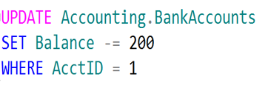

SQL Server Disk I/O (Write-Ahead Logging)
4
LDF
1. Data modification is sent to buffer cache in memory.
1
2
4. Log cache record is flushed to the transaction log
2. Modification is recorded in the log cache.
3
5. At checkpoint, dirty data pages are written to the database file.
Page
3. Data pages are located or read into the buffer cache and then modified.
Page
5
Page
Buffer Cache
MDF or NDF
Notes:
This section describes the role of the write-ahead transaction log in recording data modifications to disk. SQL Server uses a write-ahead logging (WAL) algorithm, which guarantees that no data modifications are written to disk before the associated log record is written to disk. This maintains the ACID properties for a transaction.
To understand how the write-ahead log works, it is important for you to know how modified data is written to disk. SQL Server maintains a buffer cache into which it reads data pages when data must be retrieved. When a page is modified in the buffer cache, it is not immediately written back to disk; instead, the page is marked as dirty. A data page can have more than one logical write made before it is physically written to disk. For each logical write, a transaction log record is inserted in the log cache that records the modification. The log records must be written to disk before the associated dirty page is removed from the buffer cache and written to disk. The checkpoint process periodically scans the buffer cache for buffers with pages from a specified database and writes all dirty pages to disk. Checkpoints save time during a later recovery by creating a point at which all dirty pages are guaranteed to have been written to disk.
Writing a modified data page from the buffer cache to disk is called flushing the page. SQL Server has logic that prevents a dirty page from being flushed before the associated log record is written. Log records are written to disk when the log buffers are flushed. This happens whenever a transaction commits or the log buffers become full.
Key Points:
SQL Server uses the buffer pool to minimize the amount of disk I/O that must be done against the data file. When a page is required for a read or write operation, the buffer pool is checked first. If the page is already in the buffer pool, the operation can be satisfied from memory only.
When a modification happens, the change is made to the data page in memory first, and then a log record is written to the transaction log file. The page will not be written out to disk until the CHECKPOINT process comes through and flushes changes out to the data file. If the SQL Server process is shut down unexpectedly and the memory space is lost, SQL Server uses the transaction log to bring the data file up to date with any changes that were committed before the crash but not persisted to disk. This is called recovery.
To optimize the I/O, SQL Server will attempt to gather pages together so that larger chunks of a file can be read or written in a single operation. For reads, SQL Server has a read ahead mechanism that will read contiguous pages from an object in a single request if needed by a query. For writes, SQL Server will gather together a chunk of contiguous pages that have been modified so they can be written in a single request.
Additional Reading:
SQL Server Transaction Log Architecture and Management Guide
From <https://docs.microsoft.com/en-us/sql/relational-databases/sql-server-transaction-log-architecture-and-management-guide?view=sql-server-ver15>
ACID properties
From <https://docs.microsoft.com/en-us/previous-versions/office/developer/server-technologies/aa480356(v=msdn.10)>
Write-Ahead Transaction Log
From <https://docs.microsoft.com/en-us/sql/relational-databases/sql-server-transaction-log-architecture-and-management-guide?view=sql-server-ver15#WAL>
Writing Pages
From <https://docs.microsoft.com/en-us/sql/relational-databases/writing-pages?view=sql-server-ver15>
Analyzing I/O Characteristics and Sizing Storage Systems for SQL Server Database Applications
From <https://docs.microsoft.com/en-us/previous-versions/sql/sql-server-2008/ee410782(v=sql.100)>

Slide 16
Log Buffer Flushing
SQL Server will flush the log buffer to the log file
SQL Server gets a commit request of a transaction that changes data.
The log buffer fills up. (Max size 60kb.)
SQL Server needs to harden dirty data pages (checkpoints)
Manually request a log buffer flush using the sys.sp_flush_log procedure
Log buffer flushing results in a WRITELOG wait type.

Slide 17
SQL Server Buffer Pool
Stores 8 kilobytes (KB) pages of data to avoid repeated disk I/O.
Pages held in the buffer until the space is needed by something else.
Lazy Writer searches for eligible buffers.
If the buffer is dirty, an asynchronous write (lazy write) is posted so that the buffer can later be freed.
If the buffer is not dirty, it is freed.
Physical
Read
Logical
Read
Buffer Pool
Memory
Disks
Notes:
Key Points:
The buffer pool generally represents the largest percentage of SQL Server memory. In NUMA systems, there will be a separate buffer pool node for each NUMA node.
The buffer pool abstracts the physical location of data and provides caching functions. All data accessed by SQL Server goes through the buffer pool. Therefore, the buffer pool can determine the data that should be stored in the cache to boost performance for frequently used objects.
There are two ways that the data is accessed from the buffer pool:
Logical read. Indicates that the data requested is already present in the cache. A logical read-only involves memory access, so the response time is optimum.
Physical read. Indicates that the data requested is not present in the cache, so the data must be found by using the database files. A physical read is a disk I/O operation, which is more expensive than memory access. When the I/O operation completes, the request is satisfied and the data is stored in the cache so that it can be accessed later.
When a query runs, the database pages that contain the data required to return the query result may or may not be located in physical memory. The query does not have the notion of data locality; it simply requests the page from the buffer pool.
If the pages are in memory, then there is a logical read of the page, which results in a cache hit. If the page is not in memory, then there needs to be a physical read of the page from the disk subsystem. This results in a cache miss event.
Additional Reading:
Buffer Management
https://docs.microsoft.com/en-us/previous-versions/sql/sql-server-2008-r2/aa337525(v=sql.105)
Growing and Shrinking the Buffer Pool Under NUMA
https://docs.microsoft.com/en-us/previous-versions/sql/sql-server-2008-r2/ms345403(v=sql.105)

Slide 18
Checkpoints
Flushes dirty pages from the buffer pool to the disk. Frequency of checkpoints varies based on the database activity and recovery interval.
Automatic (default) – Database engine issues checkpoints automatically based on the server level “recovery interval” configuration option
Indirect (new in SQL Server 2012) – Database engine issues checkpoints automatically based on the database level TARGET_RECOVERY_TIME
Manual – Issued in the current database for your connection when you execute the T-SQL CHECKPOINT command
Internal – Issued by various server operations
ALTER DATABASE [AdventureWorksPTO] SET TARGET_RECOVERY_TIME = 60 SECONDS
Notes:
Overview
For performance reasons, the Database Engine performs modifications to database pages in memory-in the buffer cache-and does not write these pages to disk after every change. Rather, the Database Engine periodically issues a checkpoint on each database. A checkpoint writes the current in-memory modified pages (known as dirty pages) and transaction log information from memory to disk and, also records the information in the transaction log.
The Database Engine supports several types of checkpoints: automatic, indirect, manual, and internal.
Note
The -k SQL Server advanced setup option enables a database administrator to throttle checkpoint I/O behavior based on the throughput of the I/O subsystem for some types of checkpoints. The -k setup option applies to automatic checkpoints and any otherwise unthrottled manual and internal checkpoints.
For automatic, manual, and internal checkpoints, only modifications made after the latest checkpoint need to be rolled forward during database recovery. This reduces the time required to recover a database.
Important
Long-running, uncommitted transactions increase recovery time for all checkpoint types.
Key Points:
Checkpoints are used by the database engine to minimize the time to recover databases in the event of a server crash or restart. Data page changes are buffered in memory to minimize disk I/O and maximize performance. If the server crashes, any changes made in-memory that have not yet been written to the data file will be lost. Upon restart, SQL Server will need to recover these changes by reading the transaction log file – rolling forward any changes that were committed at the time of the crash and rolling back any changes that were not committed at the time of the crash. This process is called “recovery.”
The “recovery interval” server option allows you to control the estimated time it will take to recover databases on the server upon restart. The default setting is 0, which allows SQL Server to control the interval (typically resulting in checkpoints about every 1 minute and < 1 minute recovery). The longer the recovery interval, the less frequent the checkpoints will be, resulting in less disk I/O on the server. The tradeoff is longer recovery time, thus longer downtime in the event of an unexpected restart. It is recommended to leave the recovery interval at the default, but if there are very frequent changes in a database, particularly changes that always affect the same page in memory, it may be beneficial to increase the interval.
Additional Reading:
Database Checkpoints (SQL Server)
From <https://docs.microsoft.com/en-us/sql/relational-databases/logs/database-checkpoints-sql-server?view=sql-server-ver15>
Configure the recovery interval Server Configuration Option
From <https://docs.microsoft.com/en-us/sql/database-engine/configure-windows/configure-the-recovery-interval-server-configuration-option?view=sql-server-ver15>
Change the Target Recovery Time of a Database (SQL Server)
From <https://docs.microsoft.com/en-us/sql/relational-databases/logs/change-the-target-recovery-time-of-a-database-sql-server?view=sql-server-ver15>

Slide 19
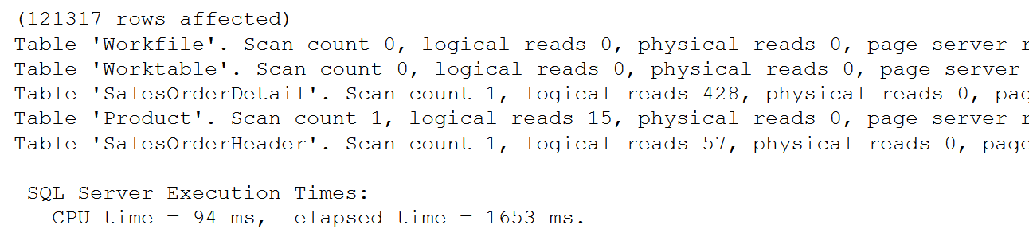
SET STATISTICS IO
SET STATISTICS IO ON
GO
SET STATISTICS TIME ON
SELECT SOH.SalesOrderID, SOH.CustomerID,
OrderQty, UnitPrice, P.Name
FROM Sales.SalesOrderHeader AS SOH
JOIN Sales.SalesOrderDetail AS SOD
ON SOH.SalesOrderID = SOD.SalesOrderID
JOIN Production.Product AS P
ON P.ProductID = SOD.ProductID
SET STATISTICS IO, TIME OFF
Used to identify physical reads and logical reads for a query
Notes:
SET STATISTICS IO (Transact-SQL) - SQL Server | Microsoft Docs
Causes SQL Server to display information about the amount of disk activity generated by Transact-SQL statements.
SET STATISTICS TIME (Transact-SQL) - SQL Server | Microsoft Docs
Displays the number of milliseconds required to parse, compile, and execute each statement.

Slide 20
Page types
Types | Page Type (ID) | Description
Data and Index | Data (1) | Data rows with all data, except text, ntext, image, nvarchar(max), varchar(max), varbinary(max), and xml data, when text in row is set to ON
 | Index (2) | Index Entries
 | Text/Image (3 or 4) | Large Object Data Type, variable length columns when the data row exceeds 8 kilobytes (KB)
Allocation | GAM, SGAM (8 and 9) | Extent Allocation information
 | PFS (11) | Information about page allocation and free space available on pages
 | IAM (10) | Information about extents used by a table or index per allocation unit
Restore | Bulk Changed Map (17) | Information about extents modified by bulk operations since the last BACKUP LOG statement per allocation unit
 | Differential Changed Map (16) | Information about extents that have changed since the last BACKUP DATABASE statement per allocation unit
Metadata | Boot (13) | Information about the database; Each database has only one Boot page
 | File Header (15) | Information about the file. It is the first page (page 0) in every file
Notes:
Pages
Take a regular book: all content in it is written on pages. Similar to a book, in SQL Server all the data rows are written on pages. In a book, all pages are the same physical size. Similarly, in SQL Server all data pages are the same size - 8 kilobytes. In a book most pages contain the data - the main content of the book - and some pages contain metadata about the content - for example table of contents and index. Again, SQL Server is not different: most pages contain actual rows of data which were stored by users; these are called Data pages and text/image pages (for special cases). The Index pages contain index references about where the data is and finally there are system pages that store variety of metadata about the organization of the data (PFS, GAM, SGAM, IAM, DCM, BCM pages). See table below for page types and their description.
As mentioned, in SQL Server, the page size is 8-KB. This means SQL Server databases have 128 pages per megabyte. Each page begins with a 96-byte header that is used to store system information about the page. This information includes the page number, page type, the amount of free space on the page, and the allocation unit ID of the object that owns the page.
Pages and Extents Architecture Guide
From <https://docs.microsoft.com/en-us/sql/relational-databases/pages-and-extents-architecture-guide?view=sql-server-ver15>

Slide 21
The Role of Allocation Maps and PFS in Object Allocation
PFS and IAM are used to determine when an object needs a new extent allocated
GAMs and SGAMs are used to allocate the extent
Notes:
PFS and IAM are used to determine when an object needs a new extent allocated
When SQL Server needs to insert a new row, but there is no space available in the current page, SQL Server uses the IAM and PFS pages to find a page with enough space to hold the row. First, SQL Server uses the IAM pages to find the extents allocated to the object. Then, for each extent, SQL Server searches the PFS pages to see if there is a page with enough free space to hold the row. Each IAM and PFS page covers a large number of data pages, which are generally stored in the memory in the SQL Server buffer pool. This means that these pages can be searched quickly.
SQL allocates a new extent to an object only when it cannot quickly find a page in an existing extent with enough space to hold the row that is being inserted. It allocates extents from those available in the filegroup by using a proportional fill algorithm (files are used in proportion to their free space). Every file in a filegroup should have a similar percentage of space used.
Heaps have one row in sys.partitions with index_id = 0. The first_iam_page column in sys.system_internals_allocation_units points to the IAM chain for the collection of heap data pages in the specified partition. The server uses the IAM pages to find the pages in the data page collection.
SQL Server uses the IAM pages to navigate through the heap. Data pages and the rows within them are not in any specific order and are not linked together. The only logical connection between data pages in a heap is the connection recorded in the IAM pages.
The IAM pages can be scanned to perform table scans or serial reads of a heap to find the extents holding pages for the heap. Because the IAM represents extents in the same order that they exist in the data files, serial heap scans progress uniformly down each file. Using the IAM pages to set the scan sequence also means that rows from the heap are not typically returned in the order in which they were inserted.

Slide 22
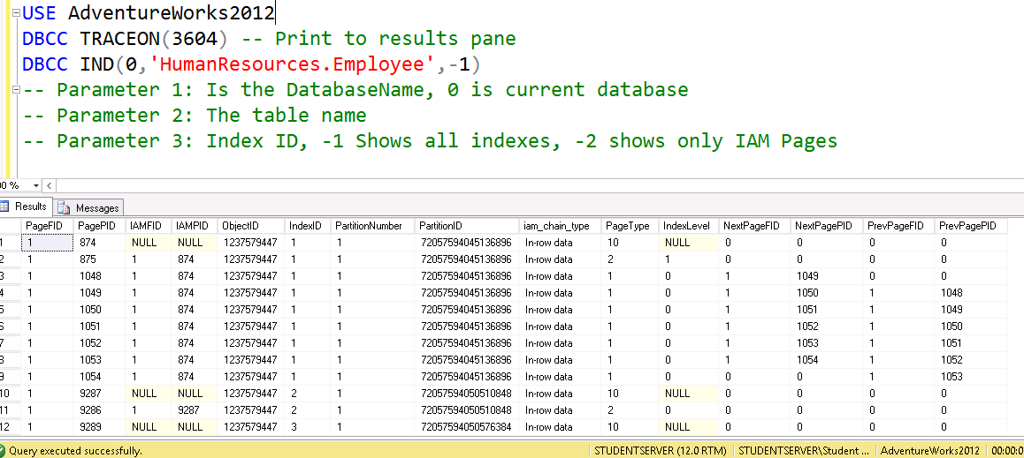
DBCC IND

Slide 23
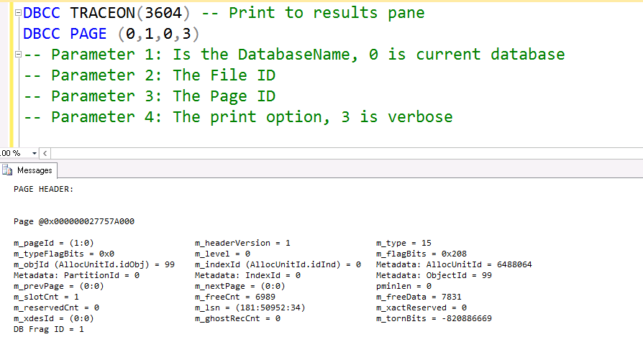
DBCC PAGE

Slide 24
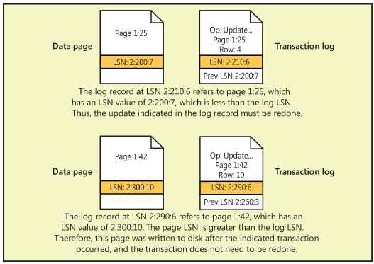
Page LSN and recovery
Last LSN in the page header
Log Record has two LSNs
Previous LSN from the data page
Current log record LSN
All used for recovery
Notes:
Every database page has an LSN in the page header that reflects the location in the transaction log of the last log entry that modified a row on that page. Each log record that represents changes to a data page has two LSNs associated with it. In addition to the LSN for the actual log record, it keeps track of the LSN that was on the data page before the change recorded by this log record. During a redo operation of transactions, the LSN for each log record is compared to the page LSN of the data page that the log entry modified. If the page LSN is equal to the previous page LSN in the log record, the operation indicated in the log entry is redone. If the LSN on the page is equal to or higher than the actual LSN for this log record, SQL Server database skips the REDO operation.
As recovery finds the last checkpoint record in the log (also, transactions that were still active at the time of the checkpoint) and proceeds from there, recovery time is short, and all changes committed before the checkpoint can be purged from the log or archived. Otherwise, recovery can take a long time and transaction logs can become unreasonably large. A transaction log cannot be truncated before the point of the earliest transaction that is still open, no matter how many checkpoints have occurred since the transaction started and how many other transactions have started or completed. If a transaction remains open, the log must be preserved because it is still not clear whether the transaction is done or ever will be done. The transaction might ultimately need to be rolled back or rolled forward.
Reference:
Microsoft SQL Server 2012 Internals

Slide 25
SQL Server 2014 VLF Growth Improvement
Is the growth size less than 1/8 the size of the current log size?
Yes: create 1 new VLF equal to the growth size
No: use the previous formula
Example of a 256 MB log file with an autogrowth setting of 5 MB
2012 and earlier: 10 auto-grows of 5MB would add 4 VLFs x 10 auto-grows
2014 and later: 10 auto-grows of 5MB each would only create 10 VLFs
Grow Iterations + Log size | Up to SQL Server 2012 | From SQL Server 2014
0 (256 MB) | 8 | 8
10 (306 MB) | 48 | 18
20 (356 MB) | 88 | 28
80 (656 MB) | 328 | 88
250 (1.2 GB) | 1008 | 258
3020 (15 GB) | 12091 | 3028
Notes:
For SQL Server 2014, the algorithm is now:
Is the growth size less than 1/8 the size of the current log size?
Yes: create 1 new VLF equal to the growth size
No: use the previous formula
Reference:
http://www.sqlskills.com/blogs/paul/important-change-vlf-creation-algorithm-sql-server-2014/
Key Points:
Fixing involves getting your t-log to a minimum size (and thus VLF number) and growing in pre-determined growth iterations until you reach the desired state, with VLFs no larger than 512 MB.
As a less conventional solution, but one that works, create a database snapshot and then revert to it. This deletes the t-log and creates a small log with two small VLFs. This is a bug that has been active since the Microsoft SQL Server 2005 product, but be aware it breaks your log backup chain.
Additional Reading:
For more information, see: VLF Posts - http://blogs.msdn.com/b/blogdoezequiel/archive/tags/vlf
For more information, see: Can log files growth affect DML? Post-CU Update -http://blogs.msdn.com/b/blogdoezequiel/archive/2011/04/26/can-log-files-growth-affect-dml-post-cu6-update.aspx
For more information, see: Fixing VLFs - http://blogs.msdn.com/b/blogdoezequiel/archive/2011/05/24/sql-swiss-army-knife-9-vlfs-revisited.aspx

Slide 26
Symmetric Multi-Processing (SMP)
Processor
Processor
Processor
Processor
Processor
Processor
Processor
Processor
Cache
Cache
Cache
Cache
Cache
Cache
Cache
Cache
Shared Bus
Memory
Notes:
Key Points:
One major problem with the symmetric multiprocessing (SMP) architecture in high CPU count systems is the contention on the system bus, sometimes referred to as the memory front or front-side bus. This is because with SMP, all CPUs use the same bus to access memory. The more CPUs that use the bus, the more the contention. Increasing the speed of the system bus has only somewhat alleviated the problem. NUMA was designed to bypass the single bus architecture.
NUMA architecture groups CPU and Memory into nodes. Nodes include their own CPUs and memory, and in some cases, their own I/O channels. Each node has its own system bus for the CPUs to reference the node memory. There are interconnects between the nodes to allow the memory to be referenced by other nodes.
Memory local to a node is called local memory. Memory located in another node is referred as foreign or remote memory. Access to foreign memory is often more expensive in time than accessing local memory. The cost of local memory access over the cost of foreign memory access is called the NUMA ratio. A higher NUMA ratio implies a higher performance impact.
Because foreign memory access is slower than accessing memory local to the node, it is important for resource-intensive applications to be NUMA aware. Relying heavily on foreign memory access will make an application run noticeably slower on NUMA hardware. SQL Server is fully NUMA-aware.
Currently, most servers on the market have a NUMA hardware configuration. Typically, each socket represents a NUMA node, although some of the newer hardware hosts 2 nodes per socket.
You can detect if your SQL Server is running on NUMA hardware by examining the startup messages in the SQL Server error log. You will see messages similar to the following:
Node configuration: node 0: CPU mask: 0x000000000000000f:0 Active CPU mask: 0x000000000000000f:0. This message provides a description of the NUMA configuration for this computer. This is an informational message only. No user action is required.
If there are more than just a single message for node 0, the hardware has a NUMA configuration.
Additional Reading: NUMA Support
http://technet.microsoft.com/en-us/query/aa363804
Understanding Non-uniform Memory Access
http://msdn.microsoft.com/en-us/library/ms178144.aspx
Recommendations and guidelines for the "max degree of parallelism" configuration option in SQL Server
http://support.microsoft.com/kb/2806535

Slide 27
Non-Uniform Memory Access (NUMA)
Processor
Processor
Processor
Processor
Processor
Processor
Processor
Processor
Cache
Cache
Cache
Cache
Cache
Cache
Cache
Cache
Memory
Memory
Node 0
Node 1
Interconnect
Notes:
Key Points:
One major problem with the symmetric multiprocessing (SMP) architecture in high CPU count systems is the contention on the system bus, sometimes referred to as the memory front or front-side bus. This is because with SMP, all CPUs use the same bus to access memory. The more CPUs that use the bus, the more the contention. Increasing the speed of the system bus has only somewhat alleviated the problem. NUMA was designed to bypass the single bus architecture.
NUMA architecture groups CPU and Memory into nodes. Nodes include their own CPUs and memory, and in some cases, their own I/O channels. Each node has its own system bus for the CPUs to reference the node memory. There are interconnects between the nodes to allow the memory to be referenced by other nodes.
Memory local to a node is called local memory. Memory located in another node is referred as foreign or remote memory. Access to foreign memory is often more expensive in time than accessing local memory. The cost of local memory access over the cost of foreign memory access is called the NUMA ratio. A higher NUMA ratio implies a higher performance impact.
Because foreign memory access is slower than accessing memory local to the node, it is important for resource-intensive applications to be NUMA aware. Relying heavily on foreign memory access will make an application run noticeably slower on NUMA hardware. SQL Server is fully NUMA-aware.
Currently, most servers on the market have a NUMA hardware configuration. Typically, each socket represents a NUMA node, although some of the newer hardware hosts 2 nodes per socket.
You can detect if your SQL Server is running on NUMA hardware by examining the startup messages in the SQL Server error log. You will see messages similar to the following:
Node configuration: node 0: CPU mask: 0x000000000000000f:0 Active CPU mask: 0x000000000000000f:0. This message provides a description of the NUMA configuration for this computer. This is an informational message only. No user action is required.
If there are more than just a single message for node 0, the hardware has a NUMA configuration.
Additional Reading: NUMA Support
https://techcommunity.microsoft.com/t5/sql-server-support/sql-server-clarifying-the-numa-configuration-information/ba-p/316753
Understanding Non-uniform Memory Access
https://docs.microsoft.com/en-us/previous-versions/sql/sql-server-2008-r2/ms178144(v=sql.105)
Recommendations and guidelines for the "max degree of parallelism" configuration option in SQL Server
https://support.microsoft.com/en-us/help/2806535/recommendations-and-guidelines-for-the-max-degree-of-parallelism-confi

Slide 28
SQL Server Configuration
Processor Configuration Settings And Best Practices
Affinity Mask
Assigns CPUs for SQL Server use
Set via sp_configure or Alter Server Configuration
Cost Threshold for Parallelism
Only queries with a cost that is higher than this value will be considered for parallelism
Max Worker Threads
Number of threads SQL Server can allocate
Recommended value is 0. SQL Server will dynamically set the Max based on CPUs and CPU architecture
Only required in specific scenarios
Only required when dealing with excessive parallelism
Max Degree of Parallelism (MAXDOP)
Maximum number of processors that are used for the execution of a query in a parallel plan. This option determines the number of threads that are used for the query plan operators that perform the work in parallel.
Notes:
Affinity Mask
The affinity mask settings on most servers will be set to 0, which allowed SQL Server to use all available CPUs on the server as and when needed. In some scenarios where you may not be running a dedicated server, you may want to split workloads to different sets of CPUs. For instance, if you have two SQL Server instances on a single machine, you may benefit from more predictable performance if each instance ran on its own subset of CPUs. As with all these configurations, a good test plan is necessary to know what is best for your environment.
References:
affinity mask Server Configuration Option - https://docs.microsoft.com/en-us/sql/database-engine/configure-windows/affinity-mask-server-configuration-option?view=sql-server-ver15
Cost Threshold for Parallelism
SQL Server uses the cost threshold for parallelism as the minimum cost to consider parallel plans. SQL Server tries to assign a cost value to each query plan as it tries to find the best plan for a given query. If the cost is below the Cost Threshold for Parallelism, parallel plans will not be looked at. Adjusting this threshold could result in more or less parallel plans and this can have a significant impact on performance. Generally, leaving this as the default is recommended, unless you have noticed an issue with the number of parallel plans being used by SQL Server for your workload.
References:
Configure the cost threshold for parallelism Server Configuration Option - https://docs.microsoft.com/en-us/sql/database-engine/configure-windows/configure-the-cost-threshold-for-parallelism-server-configuration-option?view=sql-server-ver15
Max Worker Threads
This determines the number of worker threads SQL Server can use. By default, it is set to 0, meaning that SQL Server will decide the best number based on the number of CPUs on the server and the CPU architecture. As with most settings, this should rarely, if ever, be changed.
References:
Configure the max worker threads Server Configuration Option - https://docs.microsoft.com/en-us/sql/database-engine/configure-windows/configure-the-max-worker-threads-server-configuration-option?view=sql-server-ver15
How to determine proper SQL Server configuration settings - https://support.microsoft.com/en-us/help/319942/how-to-determine-proper-sql-server-configuration-settings

Slide 29
SQL Server Configuration
MAXDOP Setting and Best Practices
Best Practice Recommendations (documented in KB 2806535):
Server with single NUMA node | Less than or equal to 8 logical processors | Keep MAXDOP at or below # of logical processors
Server with single NUMA node | Greater than 8 logical processors | Keep MAXDOP at 8
Server with multiple NUMA nodes | Less than or equal to 16 logical processors per NUMA node | Keep MAXDOP at or below # of logical processors per NUMA node
Server with multiple NUMA nodes | Greater than 16 logical processors per NUMA node | Keep MAXDOP at half the number of logical processors per NUMA node with a MAX value of 16
Notes:
The Microsoft SQL Server max degree of parallelism (MAXDOP) configuration option controls the number of processors that are used for the execution of a query in a parallel plan. This option determines the number of threads that are used for the query plan operators that perform the work in parallel. Depending on whether SQL Server is set up on a symmetric multiprocessing (SMP) computer, a non-uniform memory access (NUMA) computer, or hyperthreading-enabled processors, you have to configure the max degree of parallelism option appropriately. This article discusses the general guidelines that you can use to configure the max degree of parallelism option for SQL Server when you use the sp_configure system stored procedure.
The OPTION (MAXDOP) Transact-SQL query hints can override the max degree of parallelism option in the sp_configure value if the query specifies this option. In SQL Server 2008 and later versions, if the MAXDOP value exceeds the value that was configured by using the Resource Governor, the database engine uses the Resource Governor MAXDOP value. All semantic rules that are used with the max degree of parallelism option are applicable when you use the MAXDOP query hint. The other two options that can override or affect the MAXDOP setting are as follows:
Soft NUMA
Parallel index operations
The max degree of parallelism configuration option does not limit the number of processors that SQL Server uses. To configure the number of processors that SQL Server uses, use the affinity mask configuration option.
The MAXDOP setting applies to each operator of the plan (e.g. Clustered Index Scan). Each step will use one CPU or the number of CPUs that is specified by MAXDOP and never anything in between. If multiple operators of a plan execute concurrently in parallel, the total number of threads that are used by the query may exceed the MAXDOP setting specified.
Starting with SQL Server 2016 (13.x), during service startup if the Database Engine detects more than eight physical cores per NUMA node or socket at startup, soft-NUMA nodes are created automatically by default. The Database Engine takes care of placing logical processors from the same physical core into different soft-NUMA nodes. The recommendations in the table below are aimed at keeping all the worker threads of a parallel query within the same soft-NUMA node. This will improve the performance of the queries and distribution of worker threads across the NUMA nodes for the workload.
The maximum value of 8 that is mentioned in these guidelines is applicable for typical SQL Server activity and the overhead for the exchange operators that are used in parallel query plans. You can vary this maximum value, depending on your specific application patterns and the concurrent activity on the instance of SQL Server. For example, consider the following situations:
If you have very small number of queries that are executing at the same time compared with the number of processors, you can set the MAXDOP value to a larger value. For example, you can set the MAXDOP value to 16.
If you a have very large number of queries that are executing at the same time compared with the number of processors, you can set the MAXDOP value to a smaller value. For example, you can set the MAXDOP value to 4.
Note: Any value that you consider using should be thoroughly tested against the specific application activity or pattern of queries before you implement that value on a production server.
References:
Recommendations and guidelines for the "max degree of parallelism" configuration option in SQL Server - https://support.microsoft.com/en-us/help/2806535/recommendations-and-guidelines-for-the-max-degree-of-parallelism-confi
Configure the “max degree of parallelism”: https://support.microsoft.com/en-us/help/2806535/recommendations-and-guidelines-for-the-max-degree-of-parallelism-confi
Understanding and Controlling Parallel Query Processing in SQL Server - http://msdn.microsoft.com/en-us/library/gg415714.aspx

Slide 30
How to determine Thread Stack Memory
Maximum Worker Threads
512 + (Processors -4) *16
*
2mb per thread
Cores | Threads | Memory (MB)
4 | 512 | 1,024
8 | 576 | 1,152
16 | 704 | 1,408
32 | 960 | 1,920
64 | 1,472 | 2,944
80 | 1,728 | 3,456
Notes:
In SQL Server 2012, the max server memory setting now controls all memory allocations that were previously made through the single_page_allocator AND multi_page_allocator. While SQL CLR memory allocations come directly from VAS via VirtualAlloc, they are accounted for by the memory manager and thus are controlled by max server memory. As a result, SQL Server 2012 max server memory configuration excludes only the following allocations:
Memory allocations for thread stacks within the SQL Server process.
Memory allocation requests made directly to Windows. Examples: Allocations from extended stored procedure DLLs, objects created using OLE Automation procedures (sp_OA calls), and allocations from linked server providers
The amount of memory that is not controlled by max server memory will vary greatly from environment to environment. It will depend on the hardware in use, the number of worker threads, the use of any third-party DLLs, and so on. As an example, on the x64 platform, each thread has a 2 megabytes (MB) stack size. The default maximum number of worker threads can be calculated by using the following formula:
Maximum worker threads = (512+ (<# of processors> -4) * 16)
Therefore, on a system with 16 cores, the maximum number of worker threads will be 704. Multiply that by 2 MB per thread and you end up with 1,408 MB of memory for just the thread stacks in addition to what is being used by the memory manager. This should be kept in mind when estimating SQL Server memory usage for a particular instance and considered when configuring max server memory.
Additional Reading:
Memory configuration and sizing considerations in SQL Server 2012
http://support.microsoft.com/kb/2663912
Is there a reason why this AND is all caps? Unless you are referring to the Boolean operator, please change to lower case
Please define VAS

Slide 31
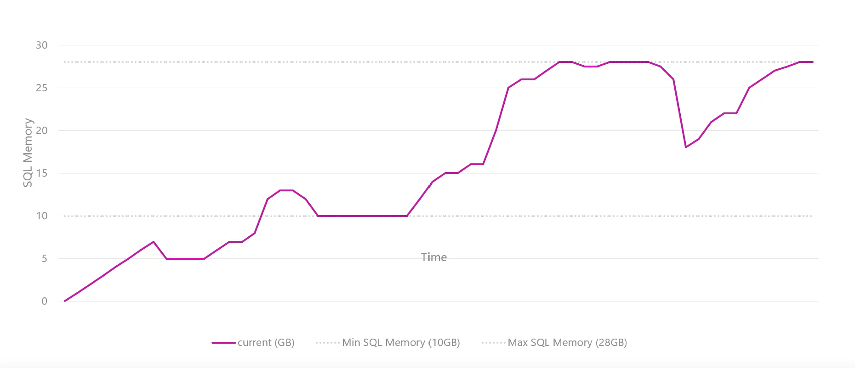
Dynamic Memory Management
Notes:
Key Points:
Low memory conditions are typically related to one of the following issues:
Buffer pool. The database caching mechanism must grow the buffer pool to improve the response time, but there is no memory remaining to do this.
VAS. Different components fail when trying to use memory because there is no VAS available.
Windows memory manager. The operating system is starting the trimming process to meet the needs of a process that is requesting memory. At this moment, SQL Server needs to discard memory to prevent it from being paged out to disk.
The Resource Monitor works in conjunction with the Windows Memory Manager and the SQL Server Memory Manager to monitor the availability of virtual and physical memory, internal cache memory targets, and the Resource Governor Pool limits. When a low memory condition is detected, notifications are passed to memory clerks who attempt to free the memory, if possible, from the various SQL Server components. Each clerk responds to the notifications in different ways depending on the component that implements the clerk. For example, the buffer pool trims memory by activating the Lazy Writer thread, while the CLR clerk may initiate Garbage Collection, and so on.

Slide 32
What is a Transaction?
A transaction is a series of one or more statements that need to operate as a single logical unit of work.
To qualify as a transaction, the logical unit of work must possess all four of the ACID properties.

Slide 33


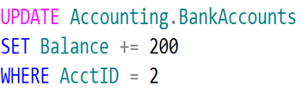
Logical Units of Work – Auto Commit Transactions
$200
John
Jane
Transaction 1
Transaction 2

Slide 34
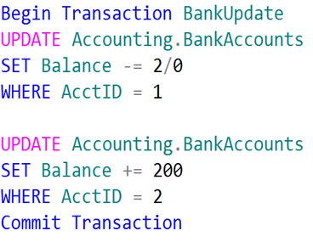
Single Logical Unit of Work – Explicit Transactions
John
Jane
Transaction 1
$200

Slide 35
Transactions must pass the ACID test
Atomicity – All or Nothing
Consistent – Only valid data
Isolated – No interference
Durable – Data is recoverable

Slide 36
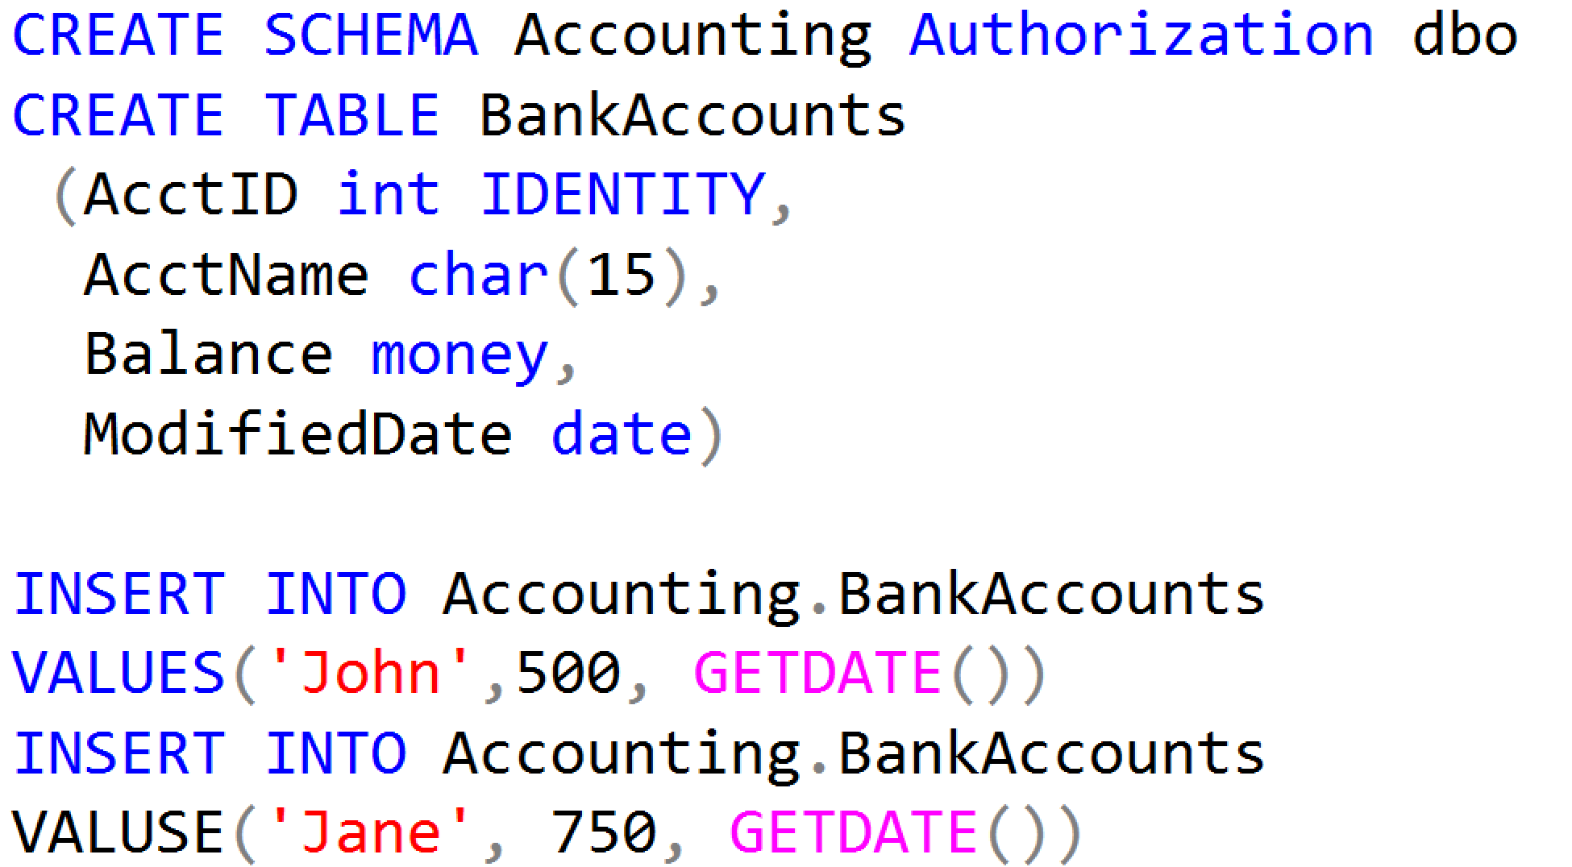
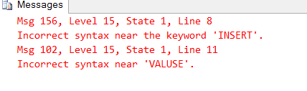
Working with Transactions

Slide 37
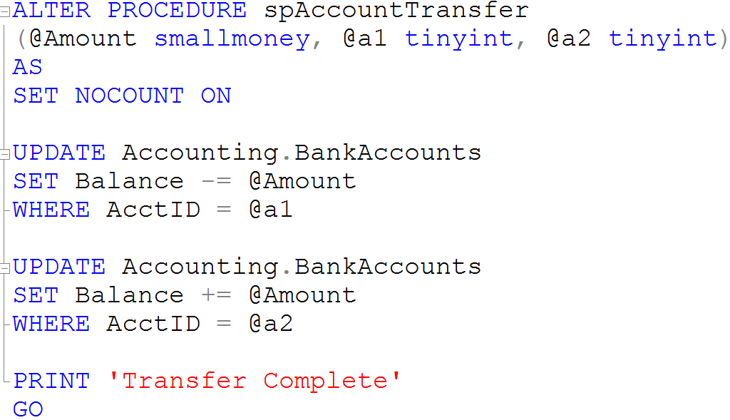
Creating Stored Procedures

Slide 38
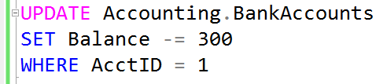
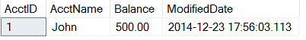

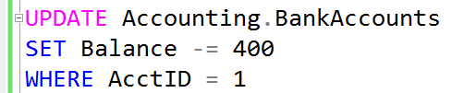
What is a Lock?
Transaction 1
Transaction 2
TSQL2012.mdf

Slide 39
Transaction Isolation Levels
Isolation Level | Dirty Read | Lost Update | Nonrepeatable Read | Phantoms
Read uncommitted | Yes | Yes | Yes | Yes
Read committed (default) | No | Yes | Yes | Yes
Repeatable read | No | No | No | Yes
Serializable | No | No | No | No
Snapshot | No | No | No | No
Notes:
Discuss the effects that each of the transaction isolation levels has on data access. Be sure that students understand the READ COMMITTED isolation level, and that it is the default transaction isolation level.
References:
SET TRANSACTION ISOLATION LEVEL (Transact-SQL): http://go.microsoft.com/fwlink/?LinkID=233927
Transaction Isolation Levels: http://go.microsoft.com/fwlink/?LinkID=209385

Slide 40
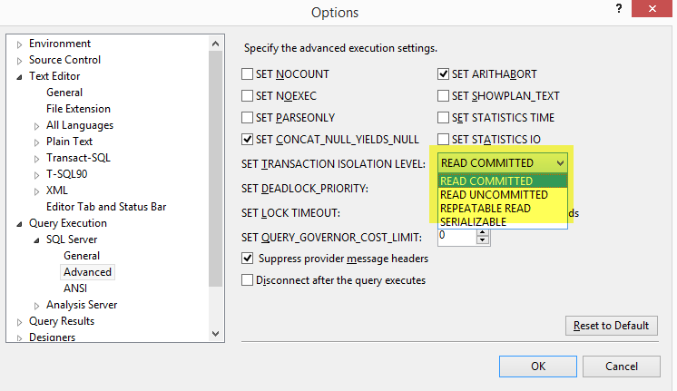
Transaction Isolation Levels
Isolation Levels

Slide 41
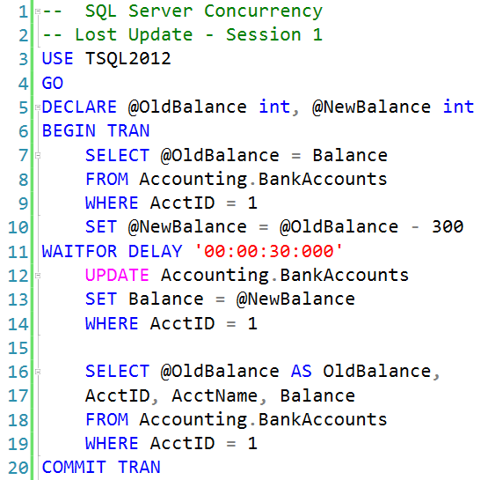
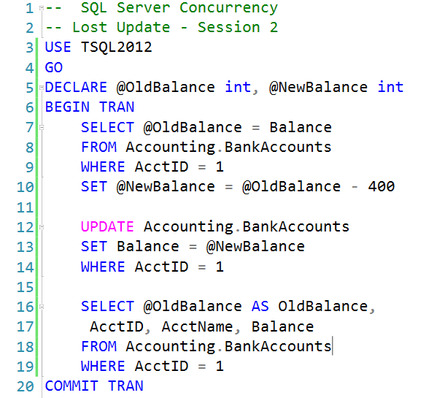
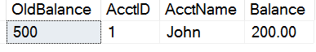
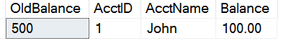
Lost Updates

Slide 42
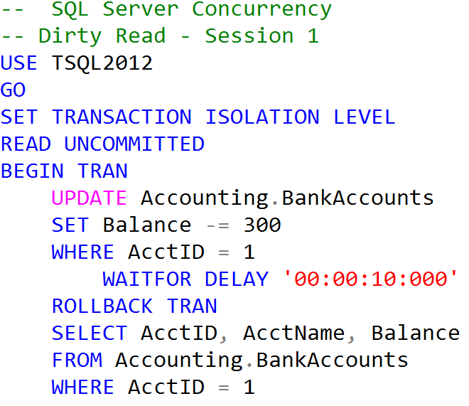
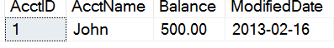
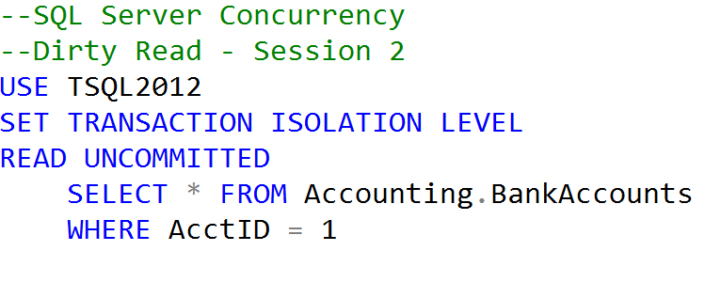
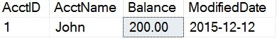
Uncommitted dependency (dirty read)
Clean Read
Dirty Read

Slide 43
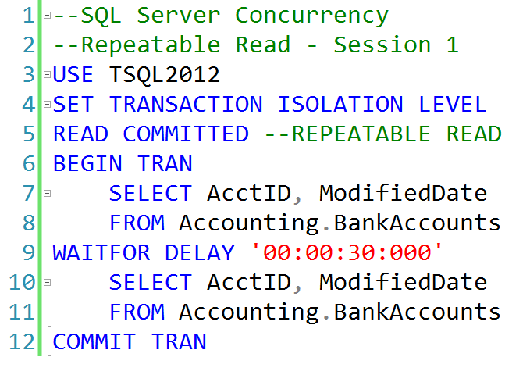
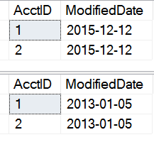
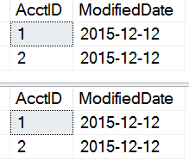
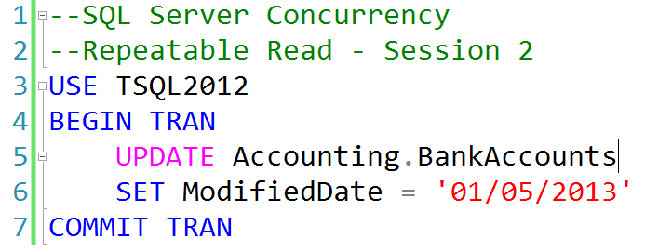
Inconsistent analysis (non-repeatable read)
READ COMMITTED
REPEATABLE READ

Slide 44
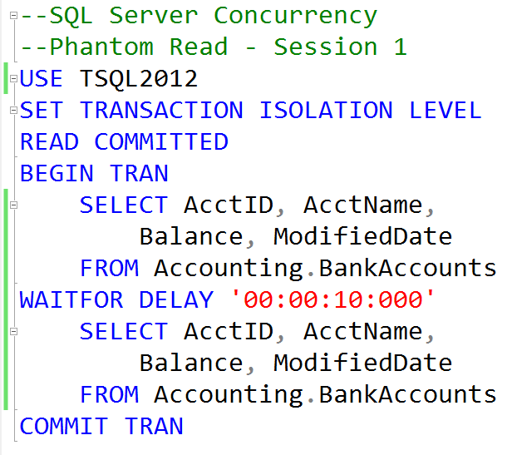
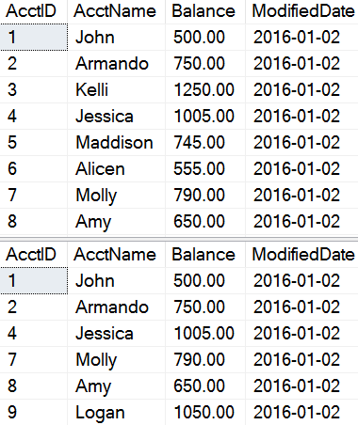
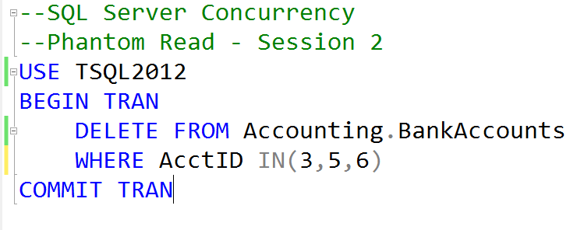
Phantom Reads
Missing records

Slide 45
How Data is Stored in Data Pages
Data stored in a Heap is not stored in any order and normally does not have a Primary Key.
Heap
Data Row 8
Data Row 2
Data Row 7
Data Row 6
Data Row 5
Data Row 4
Data Row 1
Data Row 3
Data Row 9
Clustered Index data is stored in sorted order by the Clustering key. In many cases, this is the same value as the Primary Key.
Clustered Index
Data Row 1
Data Row 4
Data Row 7
Data Row 2
Data Row 5
Data Row 8
Data Row 3
Data Row 6
Data Row 9

Slide 46
Characteristics of a Good Clustering Key
Narrow
Unique
Static
Increasing
Use a data type with a small number of bytes to conserver space in tables and indexes
To avoid SQL adding a 4-byte uniquifier
Allows data to stay constant without constant changes which could lead to page splits
Allows better write performance and reduces fragmentation issues

Slide 47
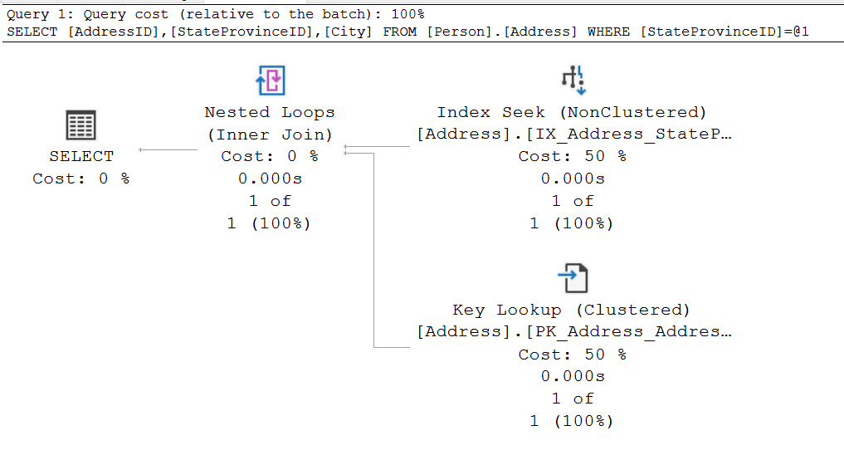
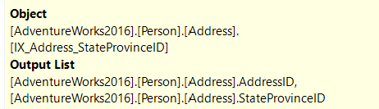

Key Lookup
Notes:
Key Points:
When nonclustered indexes are used, SQL Server may choose to use a different access method.
When the nonclustered index is sought or scanned, it is doing so to support WHERE clauses and JOINs.
However, the nonclustered index often cannot support the SELECT clause hence need to join with base table.
To put it another way, it cannot ‘cover’ the query.
=============
More Information
=============
To get the columns needed for the select clause, SQL Server needs to look up those additional columns using a Key Lookup, which reaches back to the clustered index or heap.
This is possible because each row in the nonclustered index has not only the columns that were defined, but also includes the clustering key or RID.
When the nonclustered index seek/scan finds the rows that match the filter requested, it loops over each of the rows, gets the hidden key/RID, and gets the additional columns needed.
Key lookups are costly. In fact, they are so costly that SQL Server frequently decides that the cost of a nonclustered index seek + lookup is higher than simply scanning the clustered index.
To improve Query performance one must remove the lookup from the Execution plan.
The ‘tipping point’ that determines when SQL Server will scan is pretty low, and is typically 10%.
Therefore, avoiding key lookups is often a good way to help query performance. The next lesson, “Indexing Strategy”, discusses ways that this can be done.

Slide 48
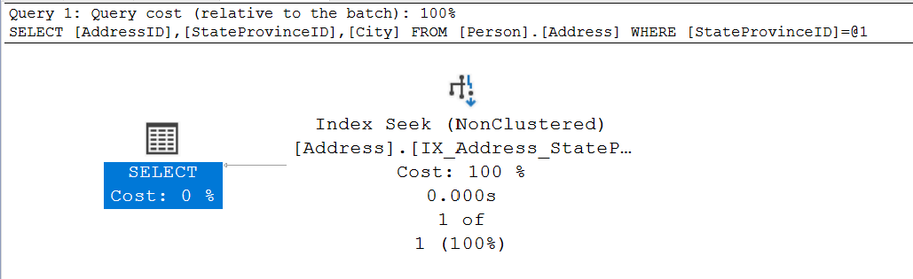
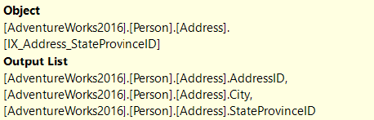
Non-Clustered Index with Included Column
Notes:
Key Points:
When nonclustered indexes are used, SQL Server may choose to use a different access method.
When the nonclustered index is sought or scanned, it is doing so to support WHERE clauses and JOINs.
However, the nonclustered index often cannot support the SELECT clause hence need to join with base table.
To put it another way, it cannot ‘cover’ the query.
=============
More Information
=============
To get the columns needed for the select clause, SQL Server needs to look up those additional columns using a Key Lookup, which reaches back to the clustered index or heap.
This is possible because each row in the nonclustered index has not only the columns that were defined, but also includes the clustering key or RID.
When the nonclustered index seek/scan finds the rows that match the filter requested, it loops over each of the rows, gets the hidden key/RID, and gets the additional columns needed.
Key lookups are costly. In fact, they are so costly that SQL Server frequently decides that the cost of a nonclustered index seek + lookup is higher than simply scanning the clustered index.
To improve Query performance one must remove the lookup from the Execution plan.
The ‘tipping point’ that determines when SQL Server will scan is pretty low, and is typically 10%.
Therefore, avoiding key lookups is often a good way to help query performance. The next lesson, “Indexing Strategy”, discusses ways that this can be done.

Slide 49
Read-Ahead Scans
Read Pages
Read-Ahead
Page 1
Page 2
Page 3
Page 4
Page 5
Page 6
Page 7
Page 8
Read-ahead anticipates the data and index pages needed to fulfill a query execution plan and brings the pages into the buffer cache before they are used by the query.
The read-ahead mechanism allows the Database Engine to read up to 64 contiguous pages (512KB) from one file.
Notes:
Reading Pages - SQL Server | Microsoft Docs

Slide 50
Columnstore Index Types
SQL Server 2012
Only Non-Clustered, Non-Updatable Columnstore Indexes.
Only available in Enterprise Edition.
SQL Server 2014
Introduced Updatable, Clustered Columnstore Indexes
Only available in Enterprise Edition.
SQL Server 2016
Introduced Updatable, Non-Clustered Columnstore Indexes
Available on Standard Edition. (Service Pack 1)
SQL Server 2019
Online rebuilds for Clustered Columnstore Indexes.
Notes:
Columnstore indexes for data warehousing.
Get started with columnstore for real-time operational analytics.
Key Points:
A columnstore index can be clustered or nonclustered. Both index function the same.
The difference is that NC index is a secondary index that’s created on a rowstore table.
Clustered columnstore index provides the primary storage for the entire table, while a nonclustered index is a secondary index that contains a copy of some of the columns in the underlying table.
Columnstore indexes are not well-suited for queries that seek specific individual values.
NCCI to perform analysis in a real time on OLTP
A clustered columnstore index can have one or more nonclustered B-tree indexes.
Enforce primary key and foreign key constraints on a clustered columnstore index. 2. Speed up queries that search for specific values or small ranges of values. 3. Speed up updates and deletes of specific rows.
Only one columnstore index can be created.
The NC columnstore index requires extra storage since it contains a copy of the data in the rowstore table.

Slide 51
Row Groups & Segments
Columns
Segments
C1
C2
C3
C4
C5
C6
Segment
Contains values for one column for a set of rows.
Segments are compressed.
Each segment is stored in a separate LOB.
It is a unit of transfer between disk and memory.
Row Group
Segments for the same set of rows
comprise a row group.
Position of a value in a column indicates to which
row it belongs to.
Row group
Segment
Notes:
For high performance and high compression rates, the columnstore index slices the table into groups of rows, called row groups, and then compresses each row group in a column-wise manner. The number of rows in the row group must be large enough to improve compression rates, and small enough to benefit from in-memory operations.
A rowgroup is a group of rows that are compressed into columnstore format at the same time.
A column segment is a column of data from within the rowgroup.
Each rowgroup contains one column segment for every column in the table.
Each column segment is compressed together and stored on physical media.

Slide 52
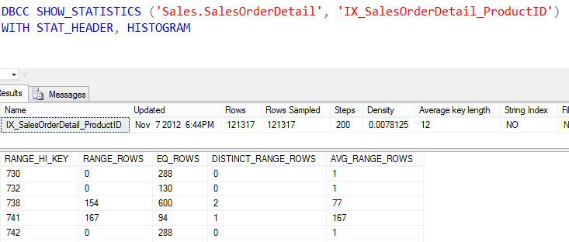
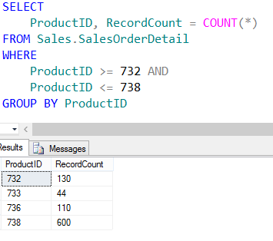
Showing Statistics

Slide 53
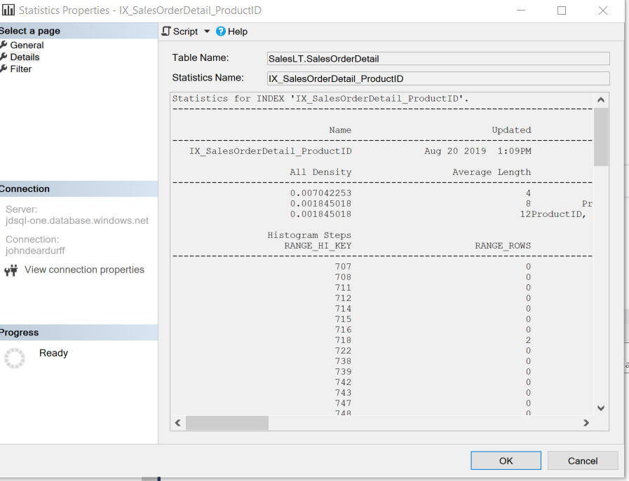
Cardinality Estimator and Statistics

Slide 54
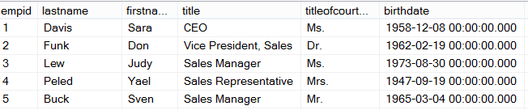
How Queries are Processed
Ad Hoc Query
Stored Procedure
First Execution
or Recompile
Syntax
Parse
Execution Context
Resolve
(Binding)
Compile
Optimize
Estimated
Execution Plan
Procedure Cache
Compile
Compile
Actual
Run Time
Execute
Execute
Execute
Execute
SQL
SQL
Sets
Sets

Slide 55
What does the binding step resolve?
Resolve aliases of columns and tables
Data types and if implicit data type conversions are needed.
Object names (Tables, Views, Columns, etc.) to see if they exist.
User permissions are checked.
Does a cached plan exist?
Notes:
This post will describe how a SQL Server will PROCESS a query. The first time through running an Ad Hoc query or Stored Procedure, SQL Server will go through each of the following steps.
The first step is to Parse the statement into keywords, expressions, and operators. This is where the syntax of your query statement is checked for accuracy. Both the first and second steps are where you will find syntax errors. In most cases, these errors are caused by misspellings or putting commas in the wrong place.
The second step is to Resolve object names (Tables, Views, Columns, etc.) to see if they exist. This step also resolves aliases of columns and tables, as well as, resolves data types and performs implicit data type conversions. This is also where user permissions are checked and if any cached plans exist. As a side note, if you read other blog posts, this step is technically called the Binding phase. I personally call this step the Resolving phase to help spell the word PROCESS as a memorization tool and also to fit the steps on a single slide during presentations.
The third step is to Optimize the query. This is where the query optimizer will find different ways of locating data from your tables based on available indexes and/or statistics. Once it figures a good enough plan to retrieve your result set using the least amount of resources, it will create an Execution Plan. Errors would only occur during this stage if there is a lack of hardware resources. Most compile errors happen at the next step.
The fourth step is to Compile the Execution Plan and store it in the Procedure Cache for future use.
Finally, the Execution Plan is passed to the Storage Engine to Execute the query and hopefully return the desired SQL Sets. This is where Run-Time errors will occur that need to be managed by using Exception Handling. (SQL Sets are normally called recordsets or rowsets, but I’m making a blog post on the PROCESS of queries not the PBOCERS of queries).
Additional submissions of the query from a Stored Procedure, will check the Procedure Cache for existing or similar Execution Plans that could be re-used for the query. If this is the case, the existing Execution Plan will be used to retrieve the SQL Sets using the Execution Context of the Stored Procedure.
It is possible for an Ad Hoc query to also re-use an existing plan from the procedure cache if the only thing that has changed in the query is the parameter value. Example: If a query had been written WHERE ProductID = 732 and was re-written WHERE ProductID = 738 the execution plan could be re-used, but if anything else changed, even by adding a space, the optimizer would compile a new execution plan.
One final thing. You will notice that you can have both an Estimated Execution Plan and an Actual Execution Plan. The difference is the first will show you what the plan would look like before the plan is compiled and the second will additionally add the values of actually running the plan that was placed in the procedure cache and executed.

Slide 56


Yes
Trivial Plan?
Query Plan Created
Phase 2
Compare Plans and Full Optimization
No
Phase 1b
Quick Parallel Plans
Query Optimizer Phases
Yes
No
Simplification and Statistics
Yes
No
Cost < 1.0
or
MAXDOP = 1
Cost > Cost Threshold for Parallelism
Yes
Simple Query Tables <= 3
Cost < 0.2
Phase 0 Transactional Processing
No
Phase 1a
Quick Serial Plans
Notes:
The SQL Server Query Optimizer uses cost-based optimization to create an execution plan with the least cost, but that also consumes the least amount of resources. The Query Optimizer will not evaluate all possible combinations of plans but will create a “Good Enough” plan based on available information such as statistics and the data distribution.
Trivial Plan Optimization: The Query Optimizer goes through several phases in the process of query optimization. First it must determine if the query has a trivial plan. Specially, a query that has only one plan to consider, such as, a SELECT statement where all the columns can be found in a single table or index. If a trivial plan is found, this saves the query optimizer from having to evaluate multiple plans, which reduces the workload of the optimizer. If a trivial plan is discovered then the optimization ends, and the query plan is created.
Non-Trivial Plan Optimization: When a trivial plan is unable to be generated, the query optimizer performs a simplification process to try to discover if unnecessary joins can be removed, operations can be rearranged, or commutative properties folded (Instead of 5 + 6, use 11 as a value). Additionally, before moving on to the next step, statistics, data distribution, and index metadata are added to the query tree.
Cost-based optimization: Now the query optimizer will evaluate the query across three search phases to quickly identify the plan with the least cost.
Phase 0 – Transactional Processing Phase: When online transaction processing (OTLP) queries are evaluated and there are three tables or less, the optimizer evaluates a limited number of join operators (merge, hash match, or loop) for potential plan candidates. If the estimated cost is less than 0.2 then the optimization ends, and the query plan is created.
Phase 1a – Quick Serial Plan Optimization: Additional join orders and transformation rules are evaluated to create a cost-effective serial plan. If the plan cost is less than 1.0 then the optimization ends, and the query plan is created.
Phase 1b – Quick Parallel Plan Optimization: At this point, if the cost of the plan is greater than 1.0, MAXDOP is set to a value greater than 1, and the plan cost is greater than the Cost Threshold for Parallelism; then the query optimizer repeats Phase 1 until it finds the most efficient parallel plan.
Phase 2 – Compare Plans and Full Plan Optimization: At this point the serial plan that had a cost greater than 1.0 but less than the Cost Threshold for Parallelism is compared with the most efficient parallel plan. The optimizer will then take the cheaper of the two plans and consider if there are any additional ways of optimizing the ·execution plan. At this point, the optimization ends, and the query plan is created.

Slide 57
Query Simplification phases
Constant Folding: Expressions with constant values are reduced
Quantity = 2 + 3 becomes Quantity = 5
10 < 20 becomes True
Contradiction Detection: Removes criteria that doesn’t match table constraints
Constraint: Age > 18
Contradiction: WHERE Age < 18
Domain Simplification: Reduces complex ranges to simple ranges
Complex range: ID > 10 and ID < 20 or ID > 30 and < 50
Simplified range: ID > 10 and < 50
Join Simplification: Removes redundant joins that are not necessary
Predicate Pushdown: Perform calculations only on rows returned
Notes:
The SQL Server Query Optimizer uses cost-based optimization to create an execution plan with the least cost, but that also consumes the least amount of resources. The Query Optimizer will not evaluate all possible combinations of plans but will create a “Good Enough” plan based on available information such as statistics and the data distribution.
Trivial Plan Optimization: The Query Optimizer goes through several phases in the process of query optimization. First it must determine if the query has a trivial plan. Specially, a query that has only one plan to consider, such as, a SELECT statement where all the columns can be found in a single table or index. If a trivial plan is found, this saves the query optimizer from having to evaluate multiple plans, which reduces the workload of the optimizer. If a trivial plan is discovered then the optimization ends, and the query plan is created.
Non-Trivial Plan Optimization: When a trivial plan is unable to be generated, the query optimizer performs a simplification process to try to discover if unnecessary joins can be removed, operations can be rearranged, or commutative properties folded (Instead of 5 + 6, use 11 as a value). Additionally, before moving on to the next step, statistics, data distribution, and index metadata are added to the query tree.
Cost-based optimization: Now the query optimizer will evaluate the query across three search phases to quickly identify the plan with the least cost.
Phase 0 – Transactional Processing Phase: When online transaction processing (OTLP) queries are evaluated and there are three tables or less, the optimizer evaluates a limited number of join operators (merge, hash match, or loop) for potential plan candidates. If the estimated cost is less than 0.2 then the optimization ends, and the query plan is created.
Phase 1a – Quick Serial Plan Optimization: Additional join orders and transformation rules are evaluated to create a cost-effective serial plan. If the plan cost is less than 1.0 then the optimization ends, and the query plan is created.
Phase 1b – Quick Parallel Plan Optimization: At this point, if the cost of the plan is greater than 1.0, MAXDOP is set to a value greater than 1, and the plan cost is greater than the Cost Threshold for Parallelism; then the query optimizer repeats Phase 1 until it finds the most efficient parallel plan.
Phase 2 – Compare Plans and Full Plan Optimization: At this point the serial plan that had a cost greater than 1.0 but less than the Cost Threshold for Parallelism is compared with the most efficient parallel plan. The optimizer will then take the cheaper of the two plans and consider if there are any additional ways of optimizing the ·execution plan. At this point, the optimization ends, and the query plan is created.

Slide 58
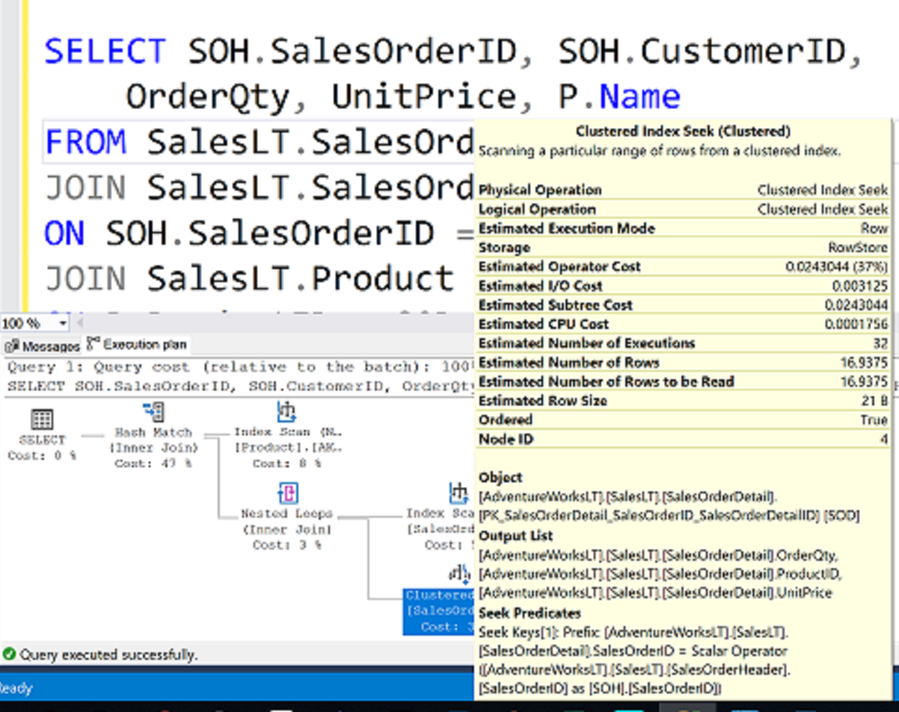
What is an Execution Plan?

Slide 59
How to see the query plan
Text and XML
 | Command | Execute query? | Include estimated row counts & stats (Estimated Query Plan) | Include actual row counts & stats (Actual Query Plan)
Text Plan | SET SHOWPLAN_TEXT ON | No | No | No
 | SET SHOWPLAN_ALL ON | No | Yes | No
 | SET STATISTICS PROFILE ON | Yes | Yes | Yes
XML Plan | SET SHOWPLAN_XML ON | No | Yes | No
 | SET STATISTICS PROFILE XML | Yes | Yes | Yes

Slide 60
How to see the query plan
Graphical execution plan
Estimated Execution Plan (Before Execution)
Live Query Statistics (During Execution)
Actual Execution Plan (After Execution)
The compiled plan.
The same as the compiled plan plus its execution context.
The same as the compiled plan plus its execution context.
This includes runtime information available after the execution completes, such as execution warnings, or in newer versions of the Database Engine, the elapsed and CPU time used during execution.
This includes runtime information during execution progress and is updated every second. Runtime information includes for example the actual number of rows flowing through the operators.
Enables rapid identification of potential bottlenecks.

Slide 61
What to look for in a query plan
Top Left Operator
Expensive Operators
Nested Loop Operator
Scans vs Seeks
Skewed Estimates
Warnings
Data Flow Statistics
Information about possible issues with the plan
Overall properties of the plan
Look from most expensive to least expensive
Thicker arrows mean more data is being passed
Possible to create index that covers query
Not necessarily bad, but could indicate I/O issues
Statistics could be stale or invalid

Slide 62
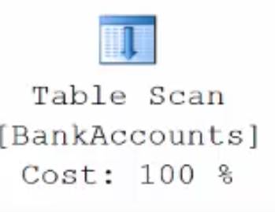
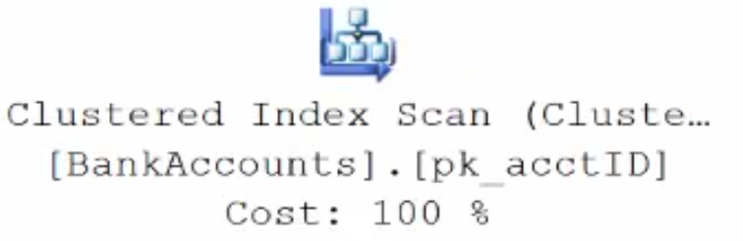
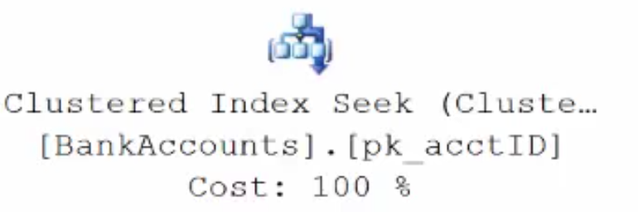
Execution Plan Table Operators
Data stored in a Heap is not stored in any order and normally does not have a Primary Key.
Clustered Index data is stored in sorted order by the Clustering key. In many cases, this is the same value as the Primary Key.
Using a WHERE statement on an Index could possibly have the Execution Plan seek the Index instead of scan.

Slide 63
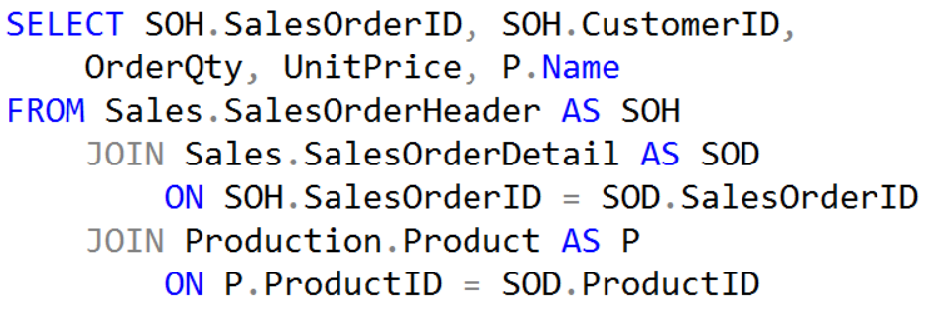
Execution Plan Join Operators (Code)

Slide 64
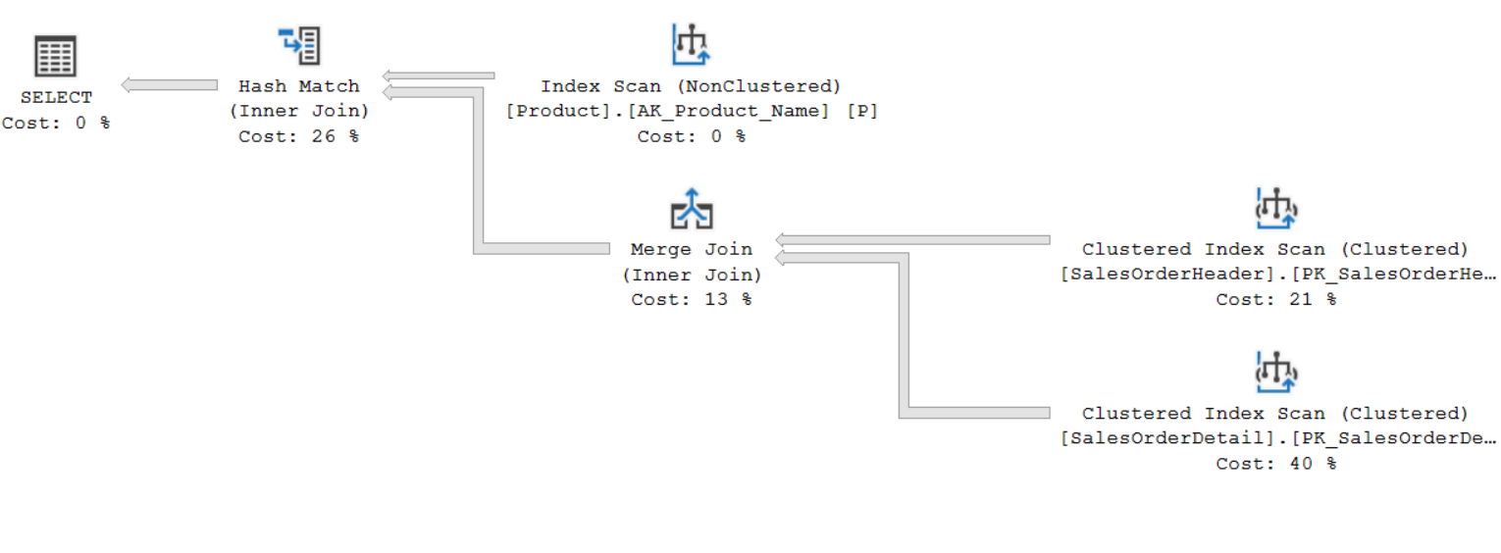
Execution Plan Join Operators (Plan)

Slide 65
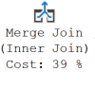
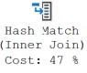
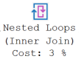
Execution Plan Join Operators
A Merge Join is useful if both table inputs are in the same sorted order on the same value.
A Hash Match is used when the tables being joined are not in the same sorted order.
A Nested Loop is use when a small (outer) table is used to lookup a value in a larger (inner) table.

Slide 66
Relationships between DMOs
sys.dm_exec_cached_plans
plan_handle
sys.dm_exec_query_stats
plan_handle
plan_handle
or sql_handle
sys.dm_exec_query_plan()
sys.dm_exec_sql_text()

Slide 67
Queries in the Plan Cache
sys.dm_exec_sql_text includes the query text for each plan in the cache.
sys.dm_exec_cached_plans contains a row for each plan in the cache with information about the cache object.
sys.dm_exec_query_stats contains execution statistics for each query in the cache. Expensive plans can be found by aggregating columns such as CPU, Reads and Elapsed Time.
the Showplan in XML format may be found in the cache, they can be viewed via sys.dm_exec_query_plan.
Plan Cache
Notes:
sys.dm_exec_cached_plans
Returns a row for each query plan that is cached by SQL Server for faster query execution. You can use this dynamic management view to find cached query plans, cached query text, the amount of memory taken by cached plans, and the reuse count of the cached plans.
sys.dm_exec_query_plan
Returns the Showplan in XML format for the batch specified by the plan handle. The plan specified by the plan handle can either be cached or currently executing.
sys.dm_exec_sql_text
Returns the text of the SQL batch that is identified by the specified sql_handle. This table-valued function replaces the system function fn_get_sql.
sys.dm_exec_query_stats
Returns aggregate performance statistics for cached query plans in SQL Server. The view contains one row per query statement within the cached plan, and the lifetime of the rows are tied to the plan itself. When a plan is removed from the cache, the corresponding rows are eliminated from this view.
For further information refer to:
sys.dm_exec_cached_plans → https://docs.microsoft.com/en-us/sql/relational-databases/system-dynamic-management-views/sys-dm-exec-cached-plans-transact-sql?view=sql-server-ver15
sys.dm_exec_query_plan → https://docs.microsoft.com/en-us/sql/relational-databases/system-dynamic-management-views/sys-dm-exec-query-plan-transact-sql?view=sql-server-ver15
sys.dm_exec_sql_text → https://docs.microsoft.com/en-us/sql/relational-databases/system-dynamic-management-views/sys-dm-exec-sql-text-transact-sql?view=sql-server-ver15
sys.dm_exec_query_stats → https://docs.microsoft.com/en-us/sql/relational-databases/system-dynamic-management-views/sys-dm-exec-query-stats-transact-sql?view=sql-server-ver15

Slide 68

Parameter Sniffing
Notes:
When a parameterized batch or stored procedure is compiled for the first time, the values of the parameters supplied with the execution call are used to optimize the statements. This process is known as parameter sniffing. If these values are typical, then most calls to that stored procedure will benefit from an efficient query plan.
CREATE PROCEDURE testProc @p1 int = null
AS
BEGIN
If @p1 IS NULL
Begin
Select @p1 = 9999
End
SELECT *
FROM sales.target
WHERE amount = @p1
END
Issues generally arise in two scenarios:
The sniffed parameter value is not typical of the values that are actually used during a typical execution.
The parameter is changed within a stored procedure before it is used in a query-parameterized queries will behave in a similar manner to batches that have been explicitly parameterized. That is, if the first execution of a query uses an atypical value when it is compiled, similar queries that share the execution plan through simple or forced parameterization may have inaccurate cardinality estimates.
Repeat of previous page

Slide 69
Notes:
Note: This should be the final slide for each presentation.

